Slide 1
Assessing the Cost-effectiveness of Warmth on Prescription Schemes for COPD Patients: A Markov Model Analysis Using R
Jack Ettinger MSc
Jack.Ettinger@parexel.com

Slide 2


Decision problem: Should the NHS pay to keep people with COPD warm over the winter?
Chronic obstructive pulmonary disease (COPD) is a cold sensitive condition. Some evidence suggests that keeping people warm may improve respiratory symptoms and reduce healthcare resource use. (1)
The cost-of-living crisis put more people at risk of fuel poverty. Nationally, an estimated 13.4% of households in England were living in fuel poverty in 2022 up from 13.1% in 2021 (latest government data).(3)
Recent restructure in the NHS meant that, in theory the NHS has a greater mandate to intervene outside of its usual role of healthcare. Lots of interest in the NHS tackling fuel poverty.
NHS
1. Asthma and Lung UK. blf.org.uk. 2022 [cited 2022 Dec 30]. What is COPD? Available from: https://www.blf.org.uk/support-for-you/copd/what-is-copd
2. Milner J, Wilkinson P. Effects of home energy efficiency and heating interventions on cold-related health. Epidemiology. 2017 Jan;28(1):86–9.
3. Department for Energy Security & Net Zero. assets.publishing.service.gov.uk. 2023 [cited 2023 May 20]. Annual Fuel Poverty Statistics in England, 2023 (2022 data).

Slide 3

Warmth on prescription: helping someone to keep warm
A variety of schemes exist in the UK, mainly run by local authorities. They involve:
Boiler replacements
Insulation
Providing fuel vouchers

Slide 4
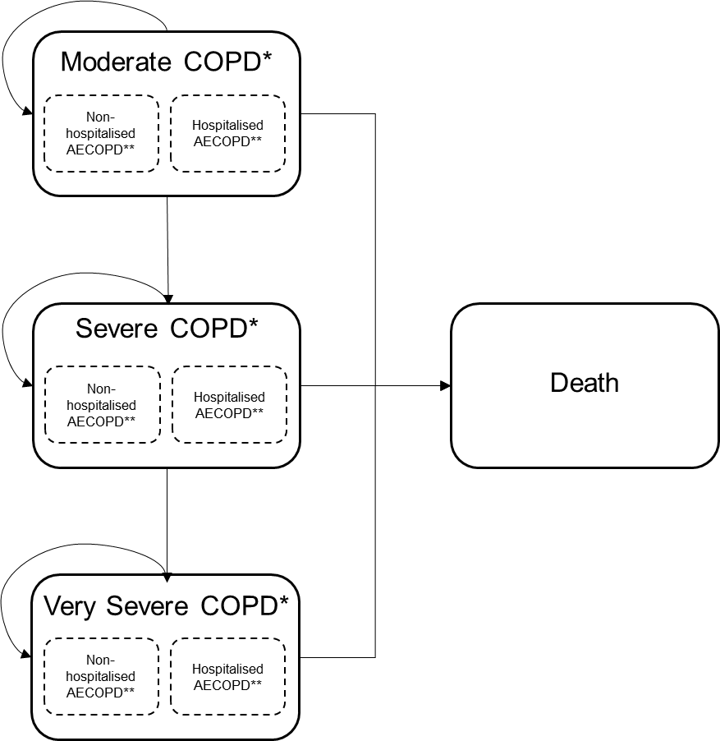
The Markov model followed standard approaches for economic models for COPD
Characteristic | Specification
Perspective | NHS in England
Analysis type | Cost utility analysis
Population | People with moderate COPD*
Comparator | No intervention (home temperature below 18°C over the winter)
Intervention | WOP scheme (home temperature above 18°C for whole year)
Model type | Markov cohort model
Time horizon | 1 year, 5 years, lifetime
Cycle length | 12 months
Discounting | 3.5% annually
Primary outcomes | QALYs
Moderate COPD: a Forced Expiratory Volume in 1 second as a percentage of the predicted value (FEV1 % predicted) between 0.5-0.79. severe COPD (FEV1 % predicted between 0.3 and 0.49. Very severe COPD: FEV1 % predicted <0.3.
**a non-hospitalised AECOPD is dealt with in the community, a hospitalised AECOPD requires a hospital admission.

Slide 5
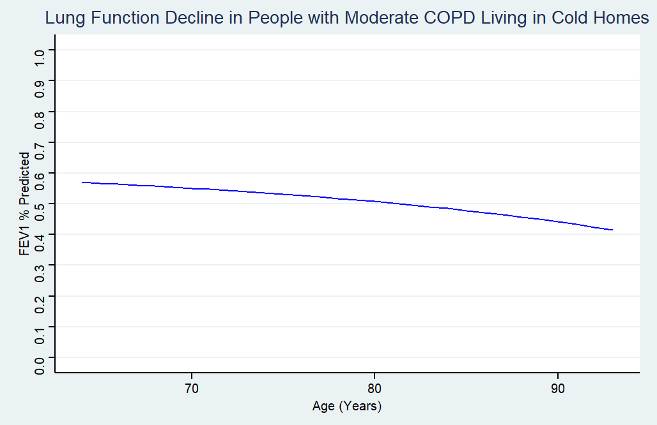
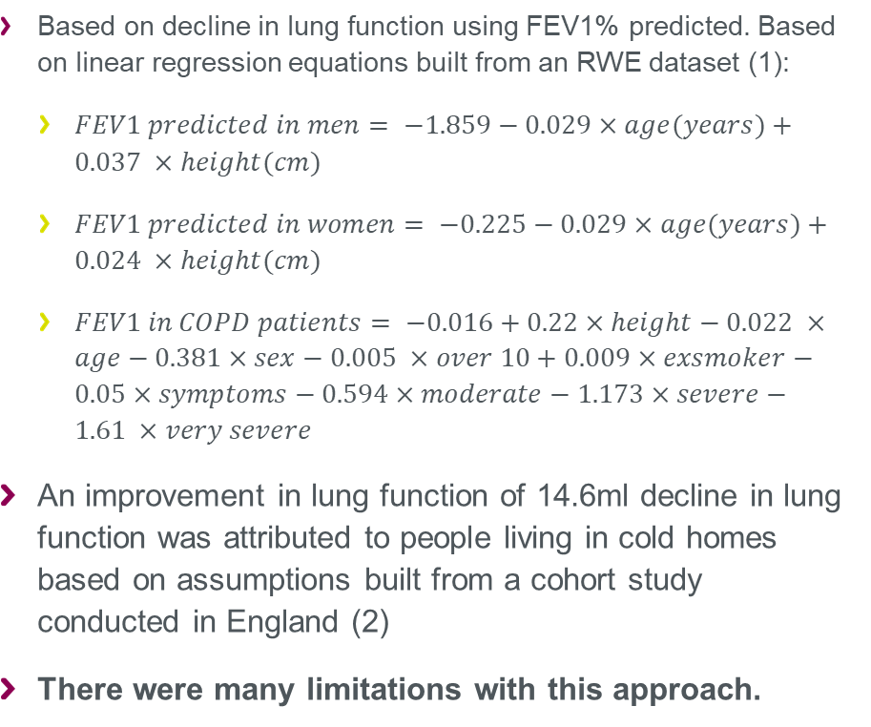
Estimating the decline in lung function in warm and cold homes
Based on decline in lung function using FEV1% predicted. Based on linear regression equations built from an RWE dataset (1):
$FEV1 predicted in men= −1.859−0.029×age(years)+0.037 ×height(cm)$
$FEV1 predicted in women= −0.225−0.029×age(years)+0.024 ×height(cm)$
$FEV1 in COPD patients= −0.016+0.22×height−0.022 ×age−0.381×sex−0.005 ×over 10+0.009×exsmoker−0.05×symptoms−0.594×moderate−1.173×severe−1.61 ×very severe$
An improvement in lung function of 14.6ml decline in lung function was attributed to people living in cold homes based on assumptions built from a cohort study conducted in England (2)
There were many limitations with this approach.
1. Starkie HJ. Health economic aspects in the management of Chronic Obstructive Pulmonary Disease [Internet]. [Glasgow]: University of Glasgow; 2010 [cited 2022 Dec 12]. Available from: https://theses.gla.ac.uk/2154/
2. Donaldson GC, Seemungal T, Jeffries D j, Wedzicha J a. Effect of temperature on lung function and symptoms in chronic obstructive pulmonary disease. European Respiratory Journal. 1999 Apr;13(4):844.
A variety of schemes exist in the UK, mainly run by local authorities.
Could involve:
Boiler replacements
Insulation
Providing fuel vouchers

Slide 6
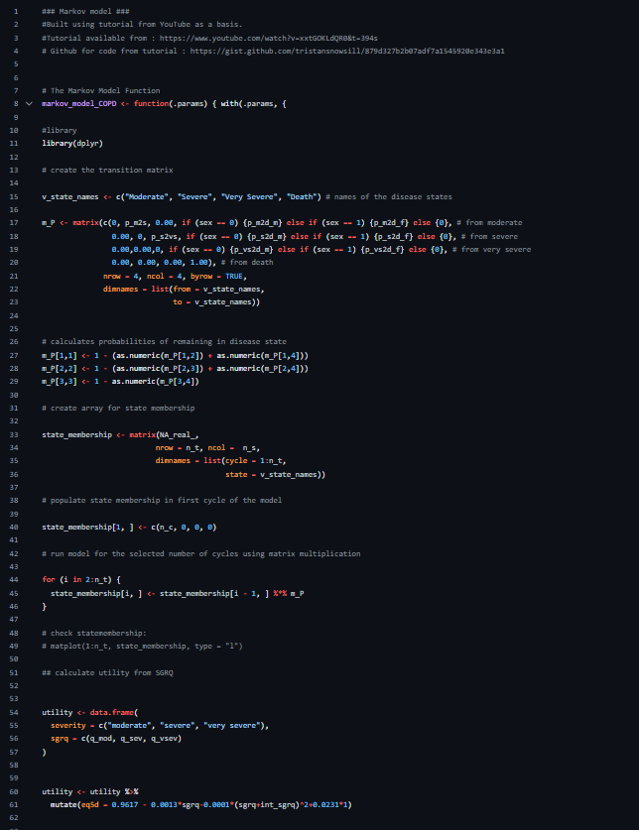
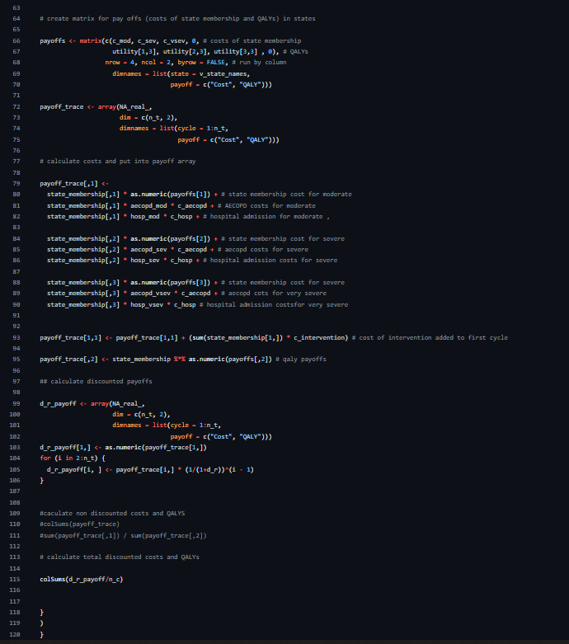
Building the model in R using simple tutorial guides
First time building economic model in R.
Used Dr Tristan Snowsill’s guide as a basis:
https://github.com/tristansnowsill
Deterministic model itself only took 120 lines of code.
Available on my github here: https://github.com/EconEttinger/

Slide 7
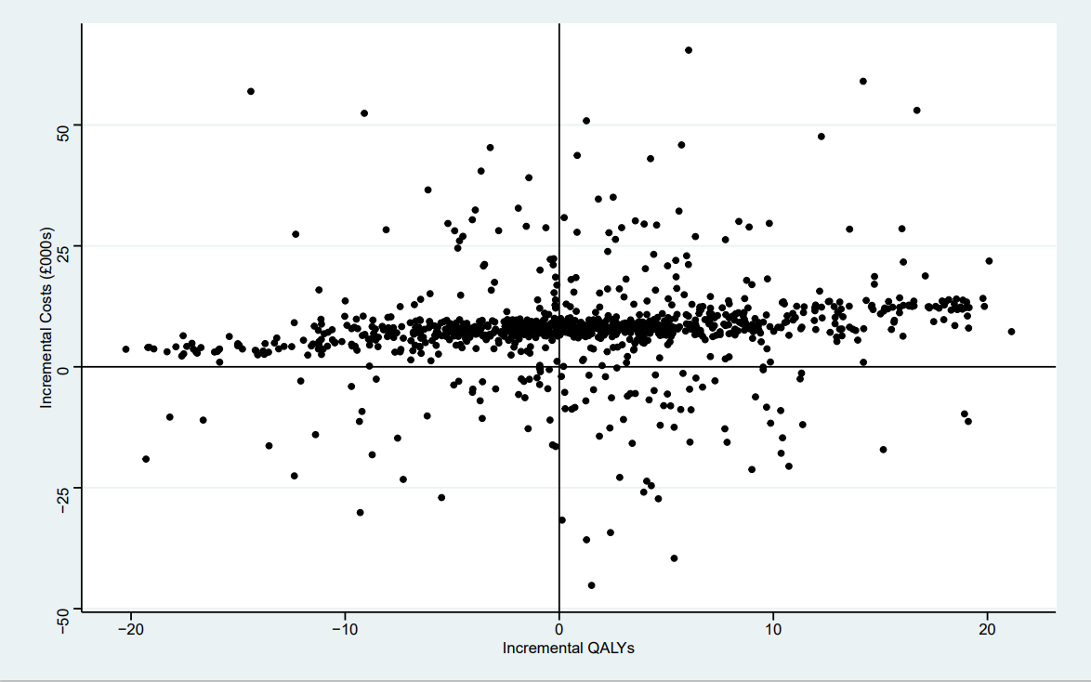
It is uncertain whether warmth on prescription schemes are beneficial from a healthcare perspective
Deterministic results (males / females) :
Study arm | Maintenance costs | AECOPD costs | Total costs | Total QALYs | Incremental cost | Incremental QALYs | ICUR
Intervention arm (WOP scheme) | £4,373 / £6,499 | £1,367 / £1,796 | £13,801 / £16,356 | 7.99 / 9.81 | £7,568 / £6,337 | 0.62 / 0.86 | £12,233 / £7,382
Comparator arm (No intervention) | £4,851 / £8,107 | £1,382 / £1,912 | £6,233 / £10,019 | 7.97 / 8.95
Probabilistic results:

Slide 8
Conclusion
Warmth on prescription schemes
There is a lack of good evidence (large scale cohort studies or randomised trails) that make it hard to assess their benefits from a health point of view.
There are lots of practical issues and interesting behavioural phenomena which means it isn’t always straight forward to implement such schemes.
There are wider benefits to society of these schemes outside of health
Modelling in R
Modularity means it is easy to spot and fix issues.
Tons of resources available to support new users
The functionality and flexibility are huge not only for coding but for using models.
In the future I would rely more on packages rather than building the code from scratch myself.

